Slide 1

Socket Communication in Cavli C10QM module
- Research on AT+QIOPEN and AT+QISEND commands
V Janaki

Slide 2
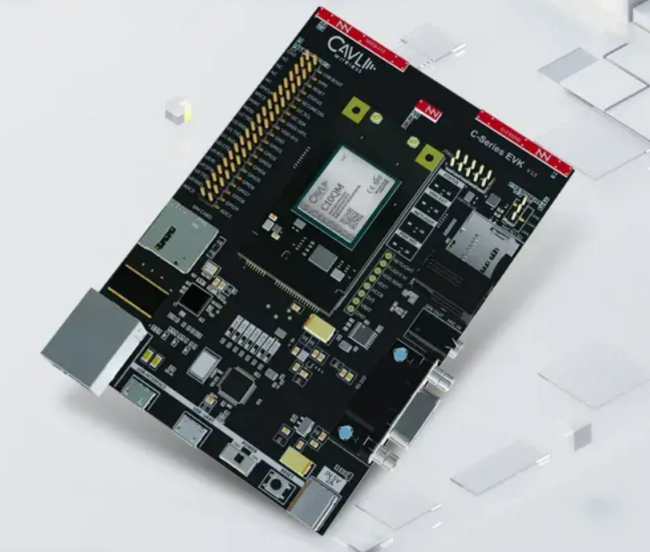
About the Module
The C10QM has been developed within the Cavli portfolio as part of a series of LTE Cat 1 modules that adhere to 3GPP release 10
It offers support for VoLTE, and SMS over IMS/SG/CS, as well as compatibility with various Internet protocols and standard industry interfaces that guarantee unbridled accessibility

Slide 3
Socket Communication Workflow
Before establishing socket communication, PDP context is configured.
For C10QM module, PDP context parameter values can be set using the AT+CGDCONT command. It is used to set the context identification parameter, PDP type and APN values.

Slide 4
Opening TCP Socket
Command:
AT+CIPSTART=<mode>, <"ip_address"|"domain_name">,<port>,[ssl_flag], [ca_cert_id],[client_cert_id],[prv_key_id]
Response:
CIPMUX=0 CONNECT OK
CIPMUX=1 CONNECT OK
+CIPSTART: Connection number OK

Slide 5
Opening TCP Socket
Parameters:
PARAMETER | EXPLANATION
<mode> | indicates the connection type (TCP or UDP)
<IP address> | Indicates remote server IP address
<port> | Remote server port (1~65535)
<domain name> | Indicates remote server domain name
[ssl_flag] | 0: ssl inactive, 1: ssl enabled
[ca_cert_id] | CA certificate ID
[client_cert_id] | Client certificate ID
[prv_key_id] | Private key ID

Slide 6
Opening TCP Socket
Example:
COMMAND | RESPONSE
AT+CIPSTART="TCP","111.205.140.139",6800 | OK CONNECT OK
AT+CIPSTART=? | +CIPSTART: (“TCP”, “UDP”), (“(0-255).(0-255).(0-255).(0-255)”), (0-65535) OK

Slide 7
Sending Data through TCP Socket
Command:
AT+CIPSEND=<connection_number>,[<length>]
>message
Response:
SEND OK
OK

Slide 8
Sending Data through TCP Socket
Parameters:
Example:
PARAMETER | EXPLANATION
<length> | indicates the length of sending data, it must be less than (1-65536)
<connection_number> | Indicates connection number
COMMAND | RESPONSE
AT+CIPSEND | > test trontrol+z SEND OK
AT+CIPSEND=1,10 | > abcdefghij 1,SEND OK

Slide 9
Other Commands
COMMAND | DESCRIPTION
AT+TCPFMT=<mode> | used to change the format of data being received through the TCP / UDP
AT+CIPSTATUS | used to query Current Connection Status
AT+CIPQSEND=<transmitting_mode (0~1)> | used to Select Data Transmitting Mode
AT+CLPORT=<mode(“TCP”|”UDP”)>,<port(1~65535)> | used to set Local Port
AT+CIPSHOWTP? | used to display Transfer Protocol in IP Head
AT+CIPSRIP? | used to show Remote IP Address And Port When Received Data
AT+CIPMODE:<mode (0~1)> | used to select TCP Application Mode
AT+CIPSHUT | used to Disconnect Wireless Connection

Slide 10
References
Cavli C10QM AT Command Manual ERV 1.9
https://www.cavliwireless.com/iot-modules/c-series/C10QM

